Slide 1
Design Slides

Slide 2
Image Optimization
Last week we didn’t cover Image Optimization
Download a LARGE Google Image
Open https://tinypng.com/
Drag & Drop or Select from filesystem
Compare Images
Do note I have seen issues with this and shadows on .png files with terrible results
Image Optimization in my experience is a great way to cut a ton of weight on your site loading

Slide 3
Submit all your wireframes
steve_fuller@berkeley.edu
Wireframes Needed
Media Page
Merch Page
Tour Dates Page
Homepage
About Page
Discography Page

Slide 4
Designing Your Website
Don’t over think this part we are not looking for award winning designs. I want to see what colors you are going with, see some images placed in, and bring some life to your wireframes
Open Photoshop or Sketch
Set canvas to 1440px wide
Height does not matter when setting up 1024px is a good starting point
I like to set my working content to 1200px
I set guides at 120px and 1,320px
For ease of designing make spacing of elements by units of 5px
Grab Custom Fonts from Google Fonts only
Bulma UI Kit
Other Kits
Bootstrap 3 UI Kit
14 Bootstrap 4 UI Kits
Free UI Kits

Slide 5
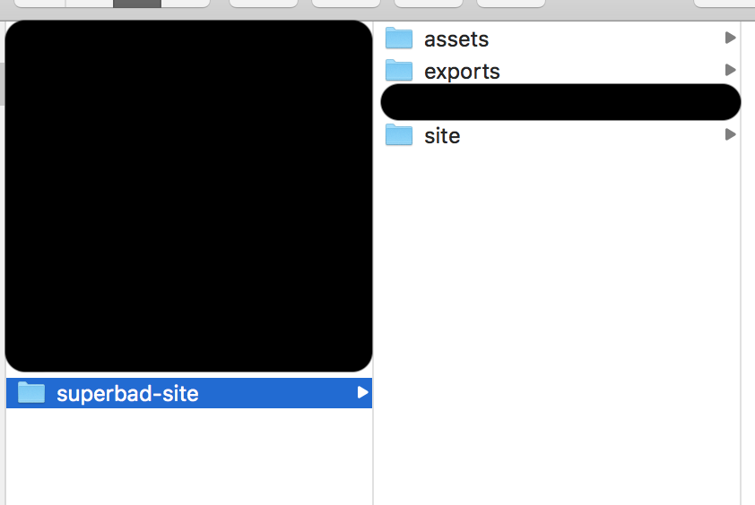
Designing Your Website
Set up a “Branding” canvas
Font sizes
Color Palette
Font Family(ies)
Make sure to pick a Google Font for easier installation
File Structure
Assets - images and any other external files to design your site
Exports - folder to save your files to be loaded into inVision
Site - project files

Slide 6
Homework
Start Designing your Website
Finish Desktop Designs for:
Homepage
About
Discography
Read Chapters
9, 10 & 11

